Slide 1
Digital Portfolio
STUDENT NAME: SATHYA.V
REGISTER NO AND NMID: 3C4FA4B891D0EE985734987EBF0AAC06
DEPARTMENT: BSC.COMPUTER SCIENCE
COLLEGE: COLLEGE/ UNIVERSITY: TIRUPPUR KUMARAN COLLEGE FOR WOMEN BHARATHIYAR UNIVERSITY

Slide 2

PROJECT TITLE

Slide 3


AGENDA
Problem Statement
Project Overview
End Users
Tools and Technologies
Portfolio design and Layout
Features and Functionality
Results and Screenshots
Conclusion
Github Link
3/21/2024 Annual Review

Slide 4

PROBLEM STATEMENT
Cybercrime incidents are rapidly increasing, but there is no single platform to showcase case studies, findings, and skills in a clear and interactive way. The task is to design and develop a web-based Cyber Crime Portfolio using HTML, CSS, and JavaScript that organizes cybercrime cases, provides search/filter features, highlights investigative skills, and allows easy communication through a contact form.

Slide 5

PROJECT OVERVIEW
The Cyber Crime Portfolio is a web-based application built with HTML, CSS, and JavaScript. It provides an interactive platform to present various cybercrime case studies, highlight investigative skills and tools, and enable users to search, filter, and view detailed reports. The portfolio also includes a responsive design and a contact section for communication, making it both professional and user-friendly.

Slide 6

WHO ARE THE END USERS?
The Cyber Crime Portfolio is intended for students, cybersecurity professionals, investigators, educators, and recruiters who want to learn about cybercrime cases, assess skills in digital forensics, or evaluate the portfolio for academic and career opportunities.

Slide 7

TOOLS AND TECHNIQUES
The Cyber Crime Portfolio is developed using HTML, CSS, and JavaScript for structure, styling, and interactivity. Techniques include responsive web design, case filtering/search, modal display for details, and form validation to ensure usability and accessibility.

Slide 8
POTFOLIO DESIGN AND LAYOUT
The Cyber Crime Portfolio follows a clean, responsive layout with sections for About, Case Studies, Skills, and Contact. It uses a grid-based design, interactive case cards, filtering options, and modal pop-ups to present information in a structured and user-friendly way across all devices.
8

Slide 9
FEATURES AND FUNCTIONALITY
The Cyber Crime Portfolio includes interactive case filtering and search, detailed case pop-ups, skills showcase, and a contact form with validation. It ensures responsive design, smooth navigation, and user-friendly interaction across devices.

Slide 10
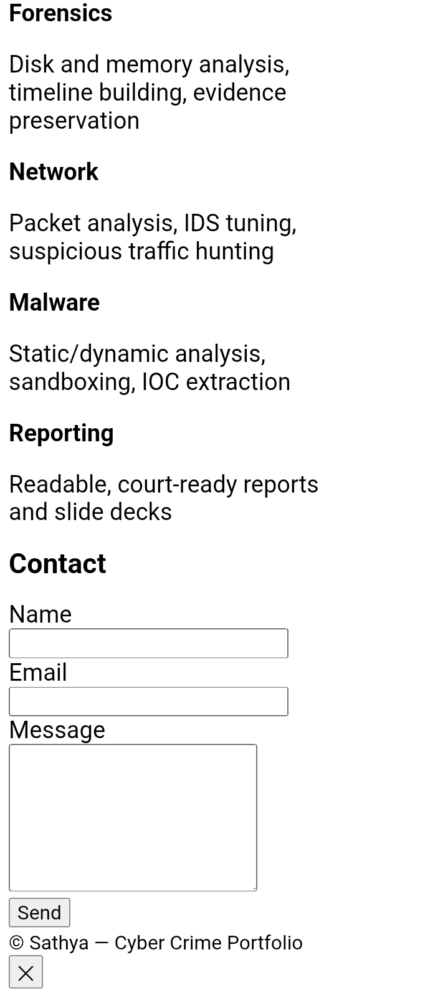
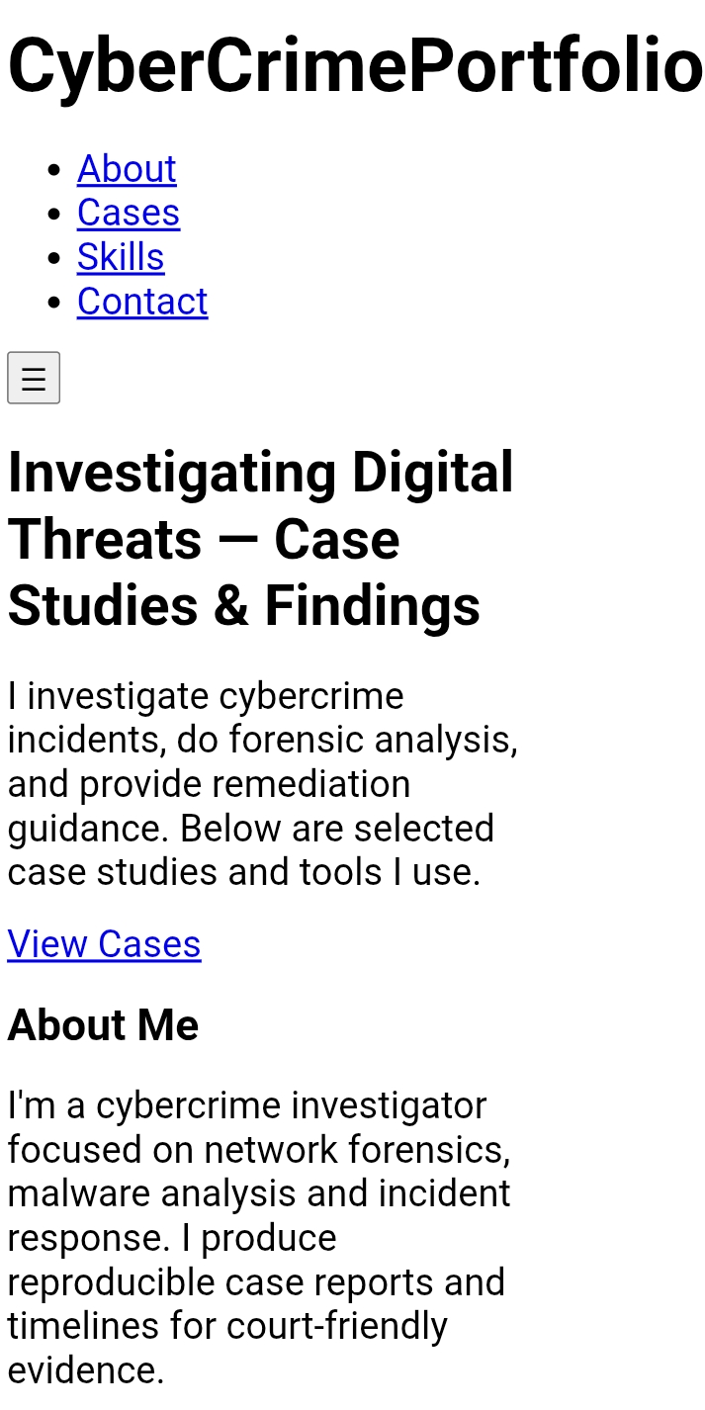
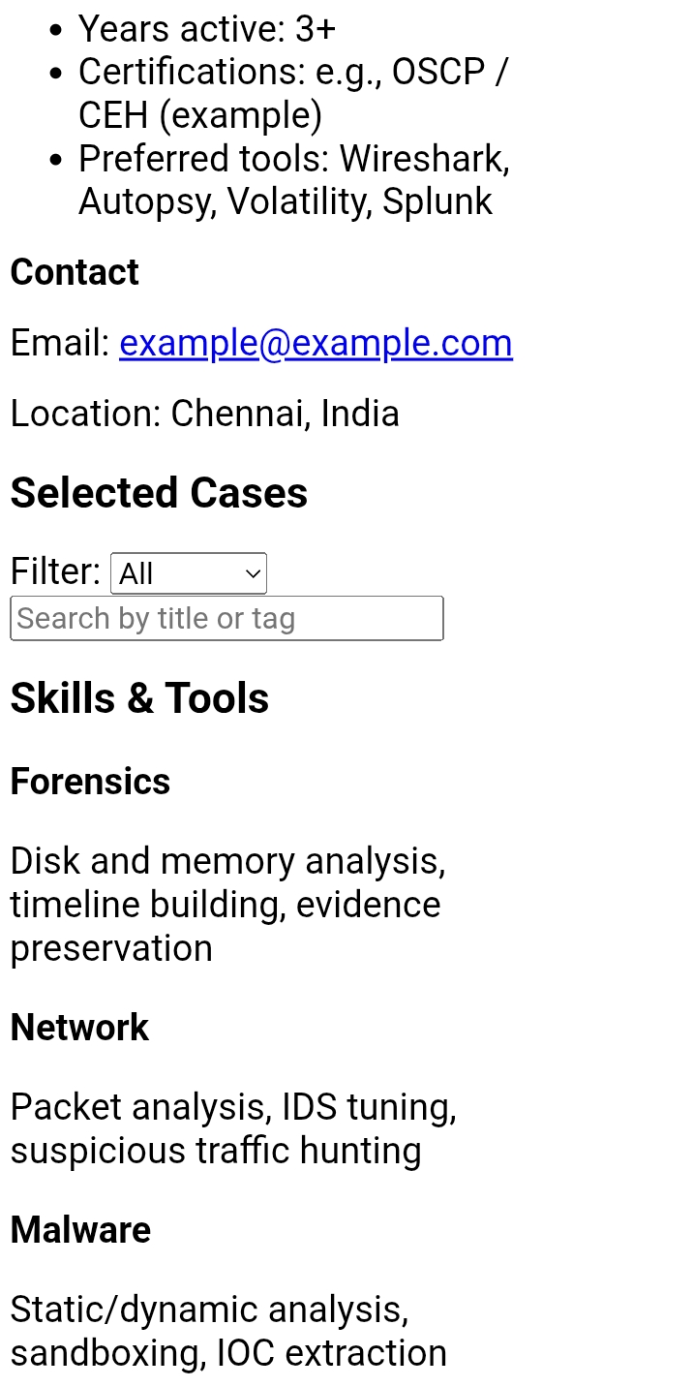

RESULTS AND SCREENSHOTS
3/21/2024 Annual Review
10

Slide 11
CONCLUSION
The Cyber Crime Portfolio effectively showcases cybercrime case studies, skills, and tools in a structured, interactive, and responsive web platform. It serves as both a professional showcase and an educational resource, highlighting the importance of digital forensics and cybersecurity awareness.
11

